Slide 1
Credit risk prediction
TCS Hackathon
BFSI garaje unit
Mandava Nidhish - CT20244446746

Slide 2
AGENDA
Introduction
Why this approach?
Methodology
Technical Architecture
Results
Challenges & Resolutions
Conclusion

Slide 3
Introduction
Credit risk evaluation is a crucial task for financial institutions to determine the likelihood of a borrower defaulting on a loan. Traditional methods rely on supervised learning, but in many cases, labeled data is limited or unavailable. The dataset provided do not contain labelled data so I explored unsupervised machine learning techniques using clustering techniques to classify credit risk into two categories that are good credit risk and bad credit risk. Our methodology included advanced data preprocessing, dimensionality reduction, clustering using KMeans and Gaussian Mixture Model (GMM), and an ensemble voting mechanism to combine the strengths of both clustering algorithms.

Slide 4
Why this approach?
The German Credit Dataset does not offer a target label i.e not a labelled dataset, making unsupervised learning a suitable choice. PCA for feature extraction helps reduce noise, improve speed, and enhance cluster separation. KMeans clustering us fast and simple, GMM clustering is flexible and probabilistic so these bot are used to balance the performance and accuracy of ensemble technique. Combining both clustering outputs via majority vote increases robustness and reduces the model’s sensitivity. This combination ensures flexibility, interpretability, and efficiency making it an ideal choice for real-world financial applications.

Slide 5
Methodology
Data preprocessing: Missing values in categorical columns like Saving accounts, Checking account were replaced using mode of the individual column, which helps maintain consistency. Categorical columns were encoded using Label Encoding into numerical values for compatibility with Machine Learning algorithms.
Outlier Detection: Outliers in numerical columns were handled using Z-score method, rows with z-score greater than 3 or less than 3 were removed to improve the clustering.
Feature scaling and Feature extraction: Numerical features were standardized using StandardScaler to bring all values to a common scale. Feature extraction method used is Principal Component Analysis(PCA), this improves performance and visualization, retaining 95% of the variance.

Slide 6
Methodology
4. Clustering Techniques:
KMeans Clustering (k=2): A partition-based clustering method that assigns points to the nearest centroid.
Gaussian Mixture Model (GMM, n=2): A probabilistic clustering method assuming data is generated from a mixture of Gaussians.
5. Ensemble Method: Predictions from KMeans and GMM were combined using a majority voting mechanism. The ensemble output represented the final predicted cluster label for each data point.

Slide 7
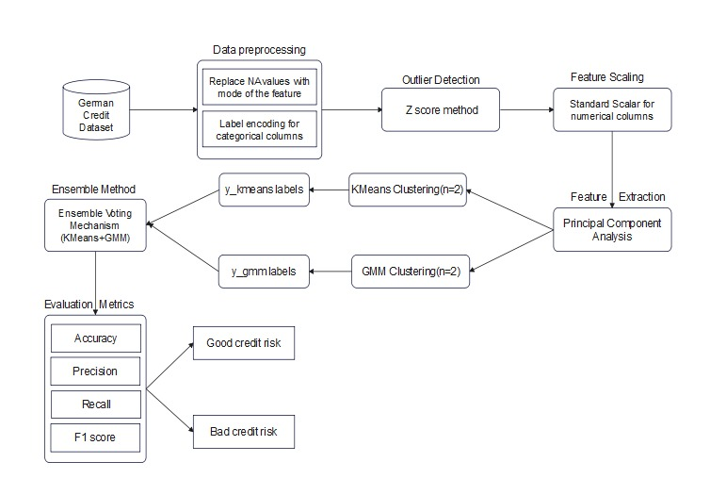
Technical architecture

Slide 8
Results
Performance Metrics | Percentage
Accuracy | 87.58%
Precision | 72.63%
Recall | 83.47%
F1 Score | 77.67%

Slide 9
Challenges & Resolutions
1. Missing values in key categorical columns - Resolved using mode of the the individual column.
2. Handling categorical data for clustering - Applied Label Encoding.
3. Outlier influence on clustering - Used Z-score filtering.
4. Sensitivity of individual models - Addressed by combining KMeans and GMM in an ensemble approach.
5. No labelled data - Created a target column using business logic to validate with the clusters.
6. High-dimensional features - PCA was used for dimensionality reduction and speed up clustering.

Slide 10
Conclusion
The work successfully demonstrated the viability of an unsupervised ensemble clustering approach for credit risk classification. By combining KMeans and GMM clustering models with PCA and data preprocessing techniques, we achieved competitive classification performance. This approach is particularly useful in real-world scenarios where labeled data is limited or unavailable. The insights drawn from clustering can help financial institutions identify high-risk customers without manual labeling efforts. With proper validation and business logic, such unsupervised learning models can support early credit screening for the financial institutions.

Slide 11
THANK YOU
Mandava Nidhish
CT20244446746
mandavanidhish@gmail.com

